Slide 1
Word Embedding
Group 13
Instructor: Dr. Nguyễn An Khương

Slide 2
Team Members
Name | Student ID
Ngô Hoài Tú | 2570536
Nguyễn Hoàng Kiên | 2570435
Huỳnh Đức Nhâm | 2570154
Trần Quốc Việt | 2570276

Slide 3
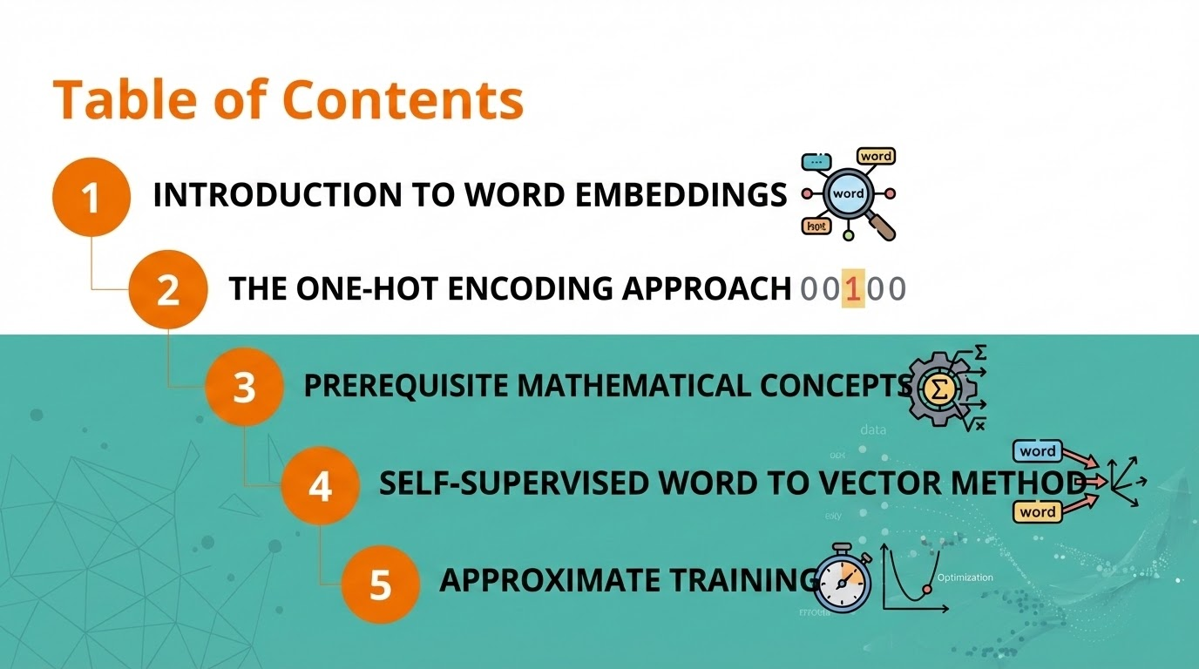

Slide 4
Introduction to Word Embeddings

Slide 5
Introduction to Word Embeddings
Problem Statement
In the field of Natural Language Processing (NLP), the fundamental challenge lies in translating human language—which consists of discrete, symbolic, and unstructured data—into a format that machine learning algorithms can process.
Computers operate on numerical data, specifically vectors and matrices. Therefore, we need a robust mapping function to transform the vocabulary of a language into a vector space.

Slide 6
Introduction to Word Embeddings
The Semantic Gap
The core problem is not merely assigning numbers to words, but preserving semantic meaning.
Traditional approaches treated words as atomic symbols with no inherent relationship.
The Result: The system could not understand that "laptop" and "notebook" are related.
The Goal: Word Embedding bridges this gap by creating a continuous vector space where geometric proximity reflects semantic similarity.

Slide 7
Introduction to Word Embeddings
Applications
Semantic Search.
Machine Translation
Recommendation Systems
Sentiment Analysis
Solving CS Problems
The Curse of Dimensionality
Unsupervised Feature Extraction:
Analogical Reasoning

Slide 8
The One-Hot Encoding Approach

Slide 9
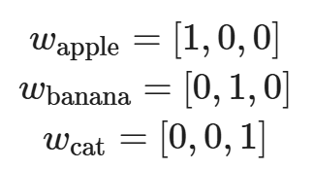
The One-Hot Encoding Approach
Definition and Mechanism
Before distributed representations, the standard method was One-Hot Encoding.
A One-Hot vector represents a word as a vector v ∈ R^{|V|} where only one element is 1 and all others are 0 . For a vocabulary V=[apple,banana,cat] :

Slide 10
The One-Hot Encoding Approach
Why is One-Hot a bad choice?
While simple, One-Hot encoding suffers from critical flaws:
High Dimensionality: For 100,000 words, every vector length is 100,000. This is computationally wasteful.
Data Sparsity: Vectors are mostly zeros, making gradient updates inefficient in neural networks.
Lack of Semantic Similarity (Orthogonality): In One-Hot space, every word is orthogonal ( 90∘ ) to every other word.The dot product of any two distinct words is always zero.
The model learns zero information about the relationship between synonyms

Slide 11
The One-Hot Encoding Approach
Transition to Probability-Based Representations
To overcome One-Hot limitations, we shift from counting to predicting.
We utilize Self-Supervised Learning based on the Distributional Hypothesis:
"A word is characterized by the company it keeps."
By analyzing the probability of a word appearing within a specific context, Word2Vec (CBOW/Skip-gram) learns dense vectors where similar words have similar probability distributions.

Slide 12
Prerequisite Mathematical Concepts
[Reference] Mikolov, T., Sutskever, I., Chen, K., Corrado, G. S., & Dean, J. (2013). Distributed representations of words and phrases and their compositionality.

Slide 13
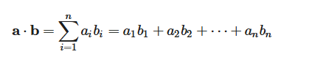
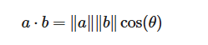
Prerequisite Mathematical Concepts
Dot Product
Definition:
Geometrically, it relates to the angle θ :

Slide 14
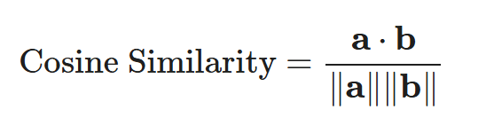
Prerequisite Mathematical Concepts
Cosine Similarity
To overcome the magnitude dependency of the dot product, we use Cosine Similarity. This is the gold standard in NLP for determining semantic similarity. It measures the cosine of the angle θ between two vectors.

Slide 15
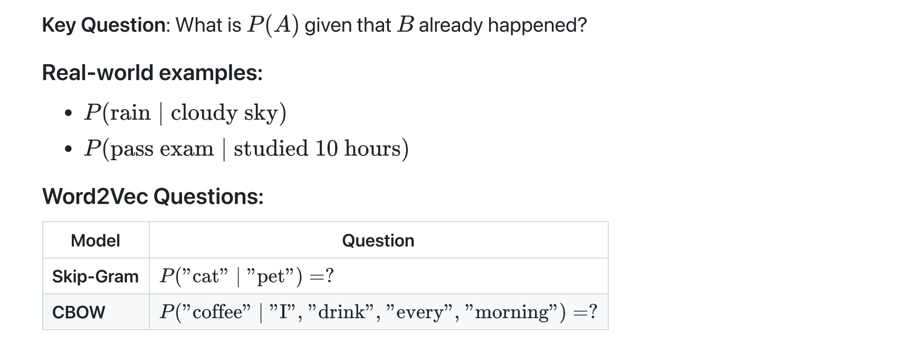
Prerequisite Mathematical Concepts
What is Conditional Probability?

Slide 16
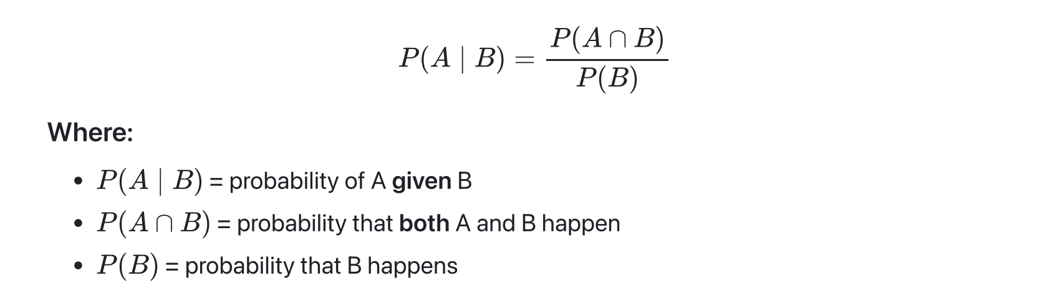
Prerequisite Mathematical Concepts
The Formula of Conditional Probability
Key Insight: Conditioning = narrowing down the sample space
Notes:
Thu hẹp phạm vi mẫu

Slide 17
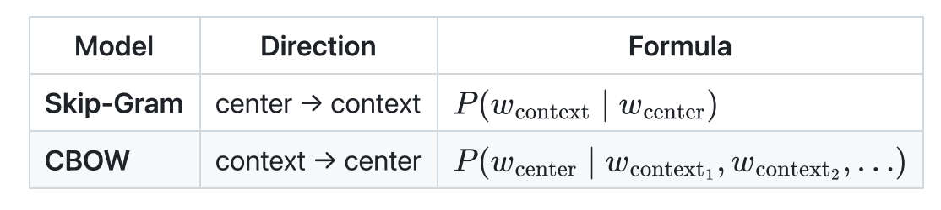
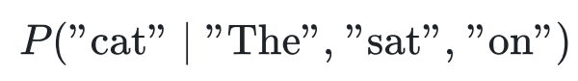
Prerequisite Mathematical Concepts
Conditional Probability (connection to Word2Vec)
Example: "The cat sat on the mat"
Skip-Gram asks: Given "cat", predict:
CBOW asks: Given ["The","sat","on"], predict:

Slide 18
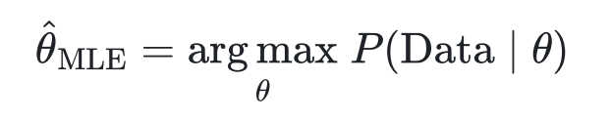
Prerequisite Mathematical Concepts
What is Maximum Likelihood Estimation (MLE)?
Core Idea: Find parameters that make observed data MOST PROBABLE
Analogy: "Detective work" - which best explains what we observed?
Notes:
Phương pháp để tìm ra bộ tham số để xác suất xảy ra dữ liệu quan sát là cao nhất

Slide 19
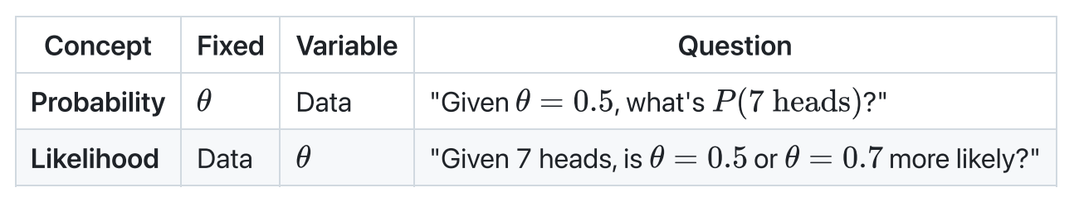
Prerequisite Mathematical Concepts
Likelihood vs Probability
Key Insight: Same number, different interpretation!
Probability: Variable is fixed, Data varies
Likelihood: Data is fixed, Variable varies

Slide 20
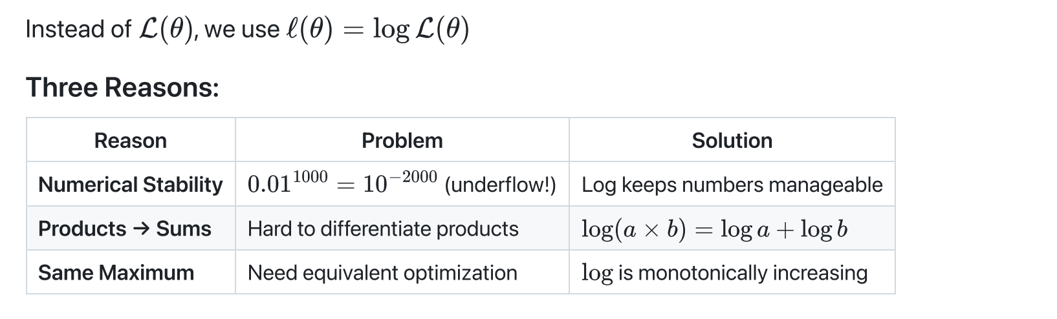
Prerequisite Mathematical Concepts
Why Log-Likelihood?
Notes:
Do xác suất là các giá trị nhỏ hơn 1, nên nhiều giá trị xác suất nhiều điểm nhân với nhau thì quá nhỏ, tiến về 0
Hàm logarit chuyển đổi các phép nhân thành cộng -> Dễ dàng đạo hàm
Logarit là hàm đồng biến -> Hàm likelihood và log-likelihood cùng điểm cực đại

Slide 21
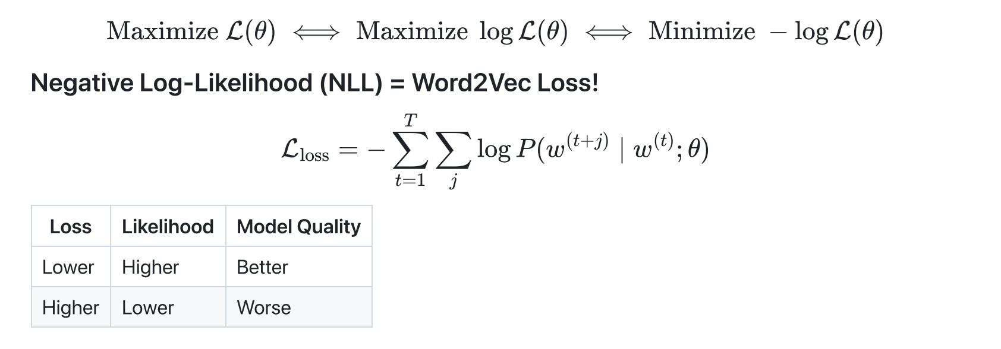
Prerequisite Mathematical Concepts
From MLE to Loss Function

Slide 22
Prerequisite Mathematical Concepts
What is Softmax?
Purpose: Convert arbitrary scores → probability distribution
Properties:
1. All outputs are positive (between 0 and 1)
2. All outputs sum to exactly 1
Perfect for: Multi-class classification where we need probability of each class
Notes:
Why Use the Exponential?
Always Positive
Amplifies Differences
Differentiable -> easy gradients!)
Preserves Ranking
Dùng để chuyển 1 vector các số thực thành dạng phân phối xác suất

Slide 23
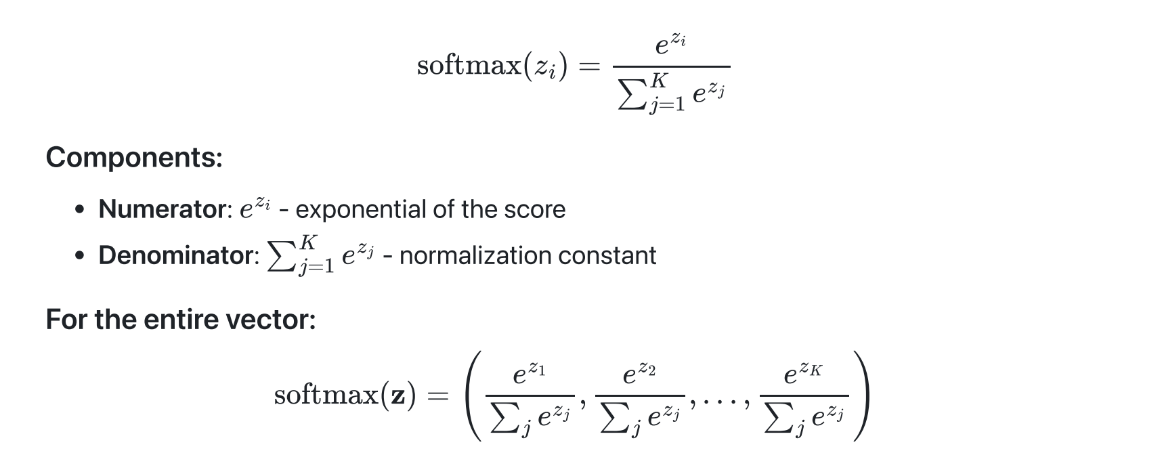
Prerequisite Mathematical Concepts
The Softmax Formula

Slide 24
Self-Supervised Word to Vector Method
[Reference] Mikolov, T., Sutskever, I., Chen, K., Corrado, G. S., & Dean, J. (2013). Distributed representations of words and phrases and their compositionality.

Slide 25
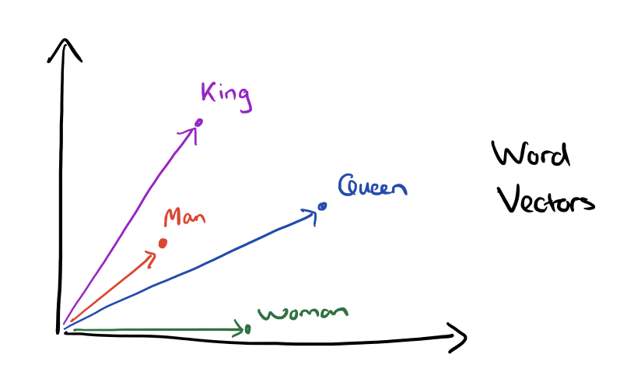
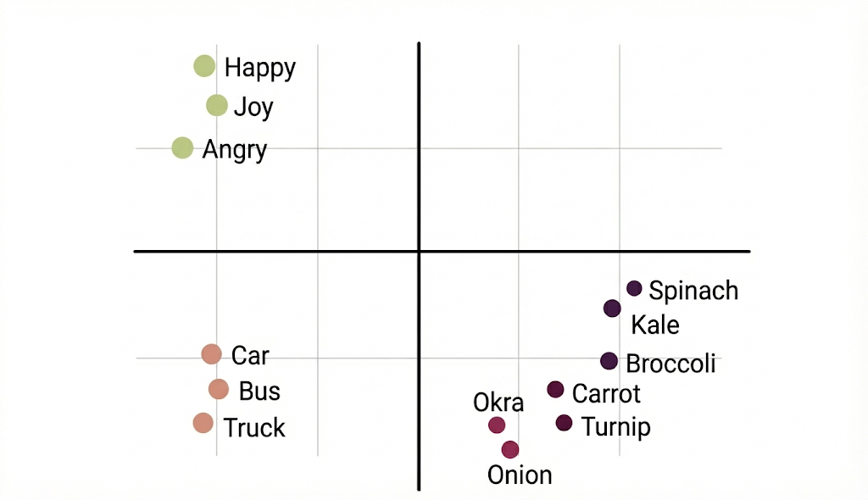
Goal
Similarity in vector space
Optimize word offset technique

Slide 26
Missions
Preserve the linear regularities among words
Maximize accuracy of simple algebraic vector operations
Minimizing computational complexity by using simple model

Slide 27
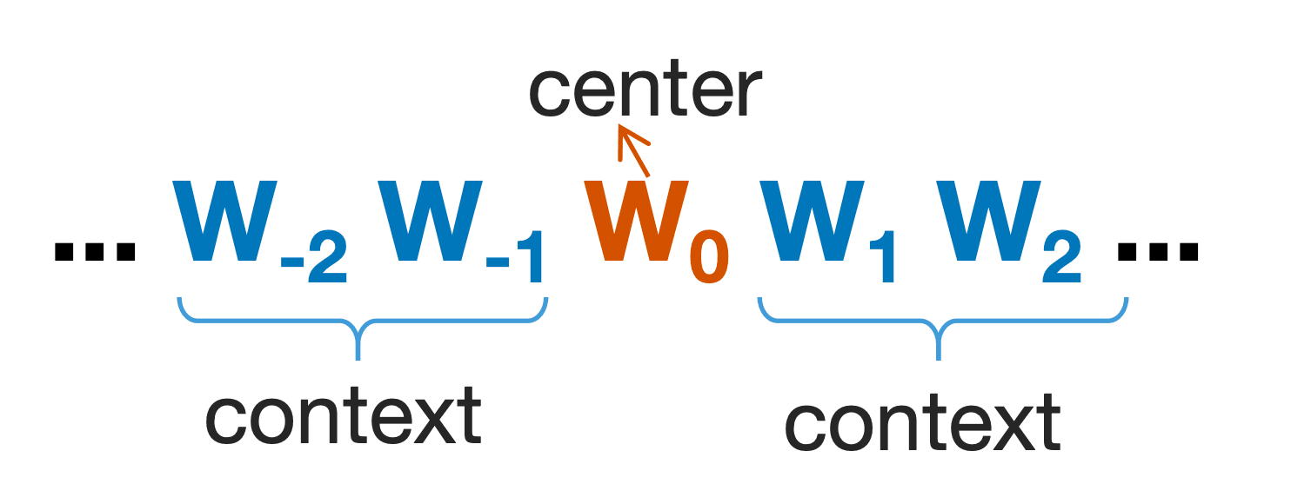

Slide 28
Continuous Bag of Words Model (CBOW)
The Dual-Vector of a Word
We have a dictionary of words calling V. Suppose, each word at index i is represented by a vector v_{i} (R^{N}) - This is also our desired outcome.
A model M (not CBOW model) help us predict a blank in a sentence.
Ex: "we are ___ friends forever",
M(“we”, “are”, “friends”, “forever”) = "good"

Slide 29
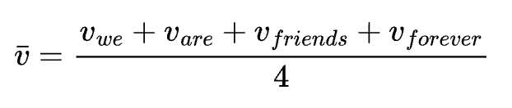
Continuous Bag of Words Model (CBOW)
The Dual-Vector of a Word

Slide 30
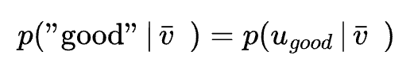
Continuous Bag of Words Model (CBOW)
The Dual-Vector of a Word
We define u_{good} (R^{N}) to be the label of class “good”
The blank word is called center word, the surrounding words are called context words

Slide 31
Continuous Bag of Words Model (CBOW)
v₋₁ v₋₂ u_{c} v₁ v₂

Slide 32
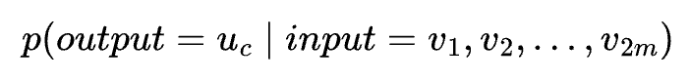
Continuous Bag of Words Model (CBOW)
The Dual-Vector of a Word
Set context window size to m, we have:
A word at index i in dictionary V has two vector (R^{N})
𝑣_{i} is the feature vector (outcome) of a word - representing its context role
𝑢_{i} is the auxiliary vector of a word - representing its center role

Slide 33
Continuous Bag of Words Model (CBOW)
The Dual-Vector of a Word
We define new vector concept calling h ∈ ℝ^{𝑁} to represent the context (list of words, not only a single word) in vector space
h
“we” “are” “friend” “forever”

Slide 34
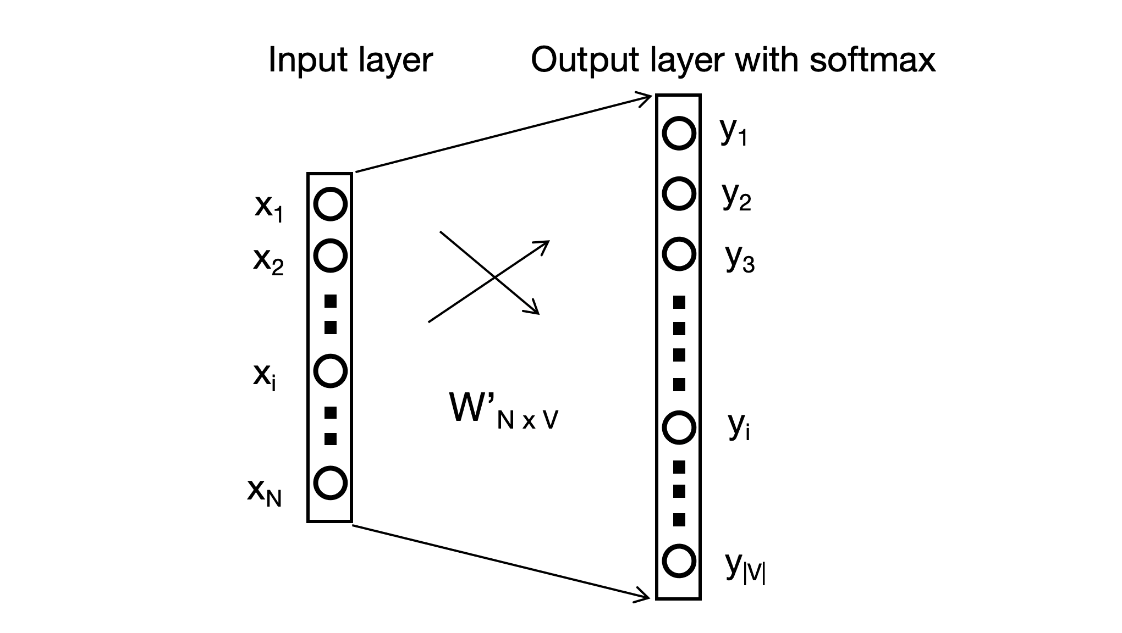
Context to Center Word
We define a new simple model 𝑀 ′ containing only two layers:
- Input layer is context h
- Output layer is One-hot vector 𝑦 ∈ ℝ^{|𝑉|} of the center word 𝑤_{𝑐} (c is index in Dict).
The output layer is handled with the softmax function
M’ help us predict a blank in a sentence.
Ex: "we are ___ friends forever",
M(“we”, “are”, “friends”, “forever”) = "good"
w_{c}
h

Slide 35
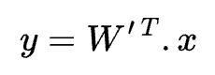
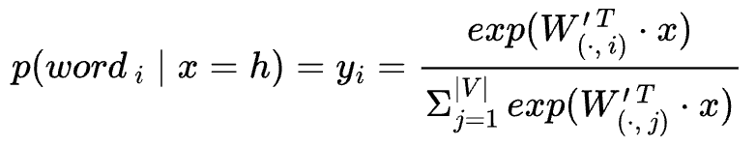
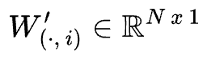
Context to Center Word
Following the softmax of this simple neural net,
we have:
where y_{i} is the output of the i-th unit in the output,
is the i-th column of the matrix W ’

Slide 36
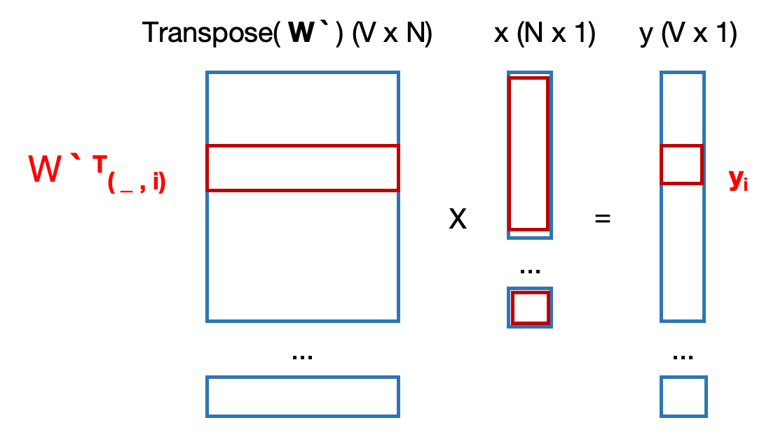
Context to Center Word
Following the softmax of this simple neural net,
we have:
where y_{i} is the output of the i-th unit in the output,
is the i-th column of the matrix W ’

Slide 37
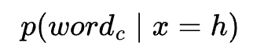
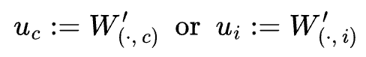
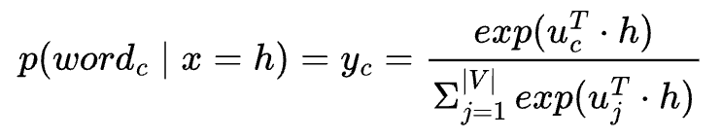
Context to Center Word
Call 𝑐 is the true index of the center word, the target of training is maximizing the probability:
The maximum 𝑝(𝑤𝑜𝑟𝑑_{𝑐} ∣ 𝑥 = h ) is related with the weights column 𝑊 ′(⋅,𝑐) so we assign:
Therefore:

Slide 38
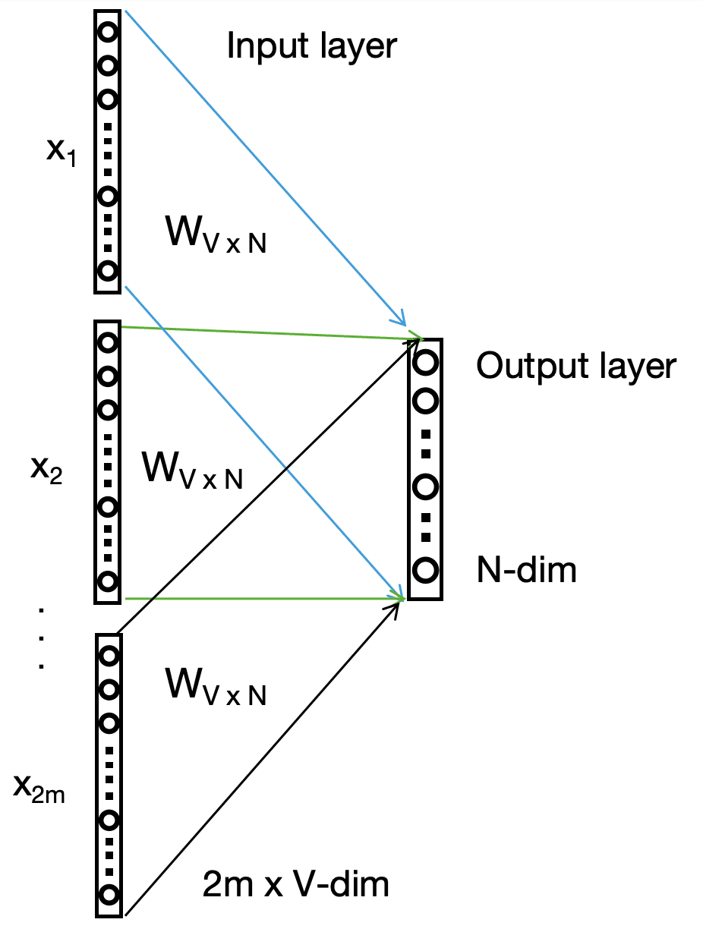
Surrounding words to Context vector
We define a new simple model 𝑀 `` containing only two layers:
- Input layer is multi-inputs which are One-hot vectors 𝑥_{𝑖} ∈ ℝ^{|𝑉|} for context 𝑤₁,𝑤₂,...,𝑤_{2𝑚}
- Output layer is 𝑦 ∈ ℝ^{𝑁}
Target of M ’ ’ : the output vector is the representation of the context (list of words) in vector space (vector h).

Slide 39
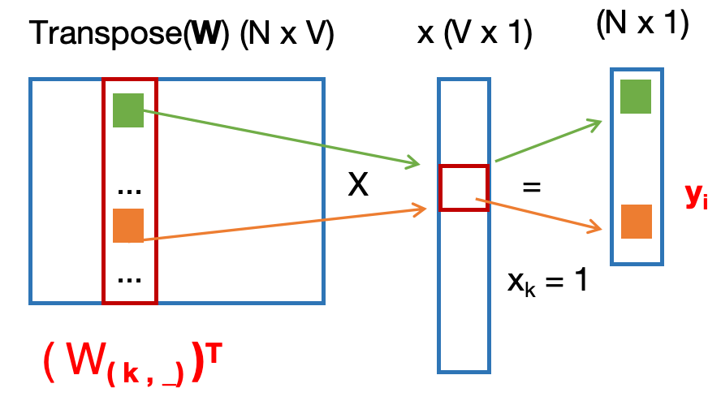
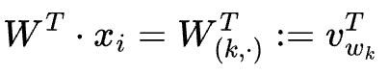
Surrounding words to Context vector
We take the average of the vectors of the input context words, and use the product of the input:
𝑊 is the weights of the model 𝑀 ’ ’ shared for all inputs.
Given a context, assuming 𝑥^{𝑘}_{𝑖} = 1 and 𝑥^{𝑘′}_{𝑖} ≠ 0 for 𝑘 ≠ 𝑘′, we set:
We can assign 𝑊 _{(𝑘, ⋅ )} := 𝑣_{𝑤 𝑘} , because the output vector is contributed by 𝑤𝑜𝑟𝑑_{𝑘} at 𝑥_{𝑖} ∼ 𝑊_{(𝑘,⋅)}

Slide 40
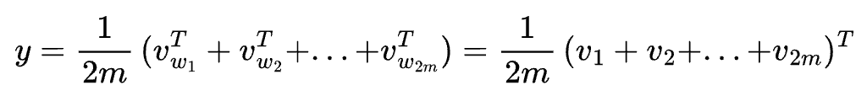
Surrounding words to Context vector
Given a context, assuming 𝑥^{𝑘}_{𝑖} = 1 and 𝑥^{𝑘′}_{𝑖} ≠ 0 for 𝑘 ≠ 𝑘′, we set:
We can assign 𝑊 _{(𝑘, ⋅ )} := 𝑣_{𝑤 𝑘} , because the output vector is contributed by 𝑤𝑜𝑟𝑑_{𝑘} at 𝑥_{𝑖} ∼ 𝑊_{(𝑘,⋅)}
Therefore:
Then, we assign y := h (context vector)

Slide 41
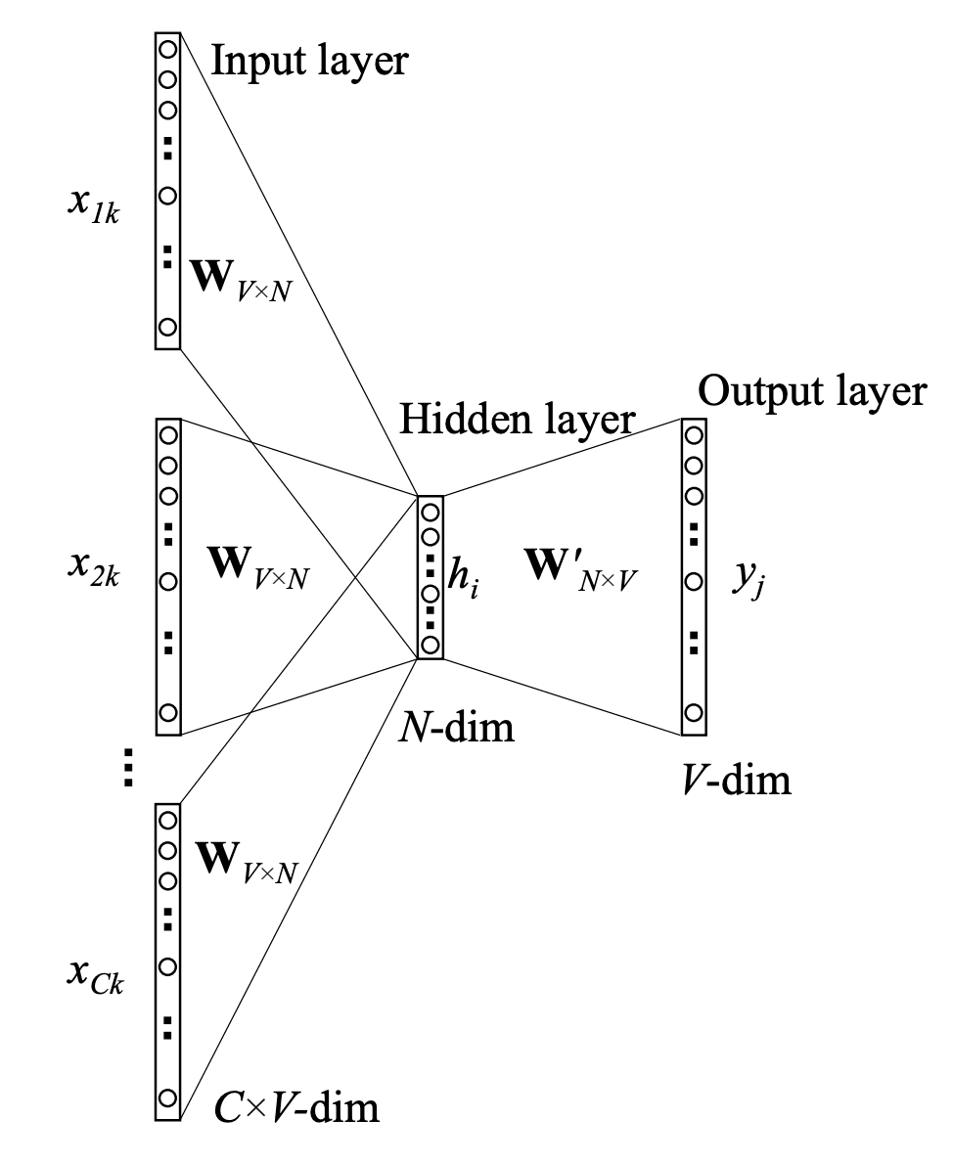
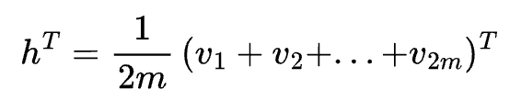
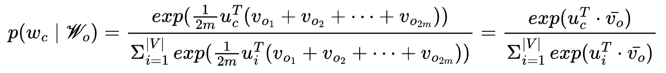
Full CBOW Model
From M `
From M ` `
Combine

Slide 42
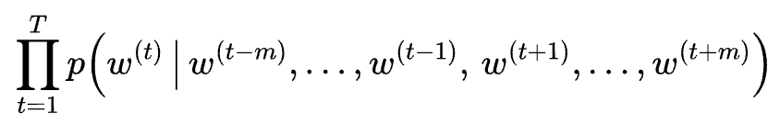
Full CBOW Model
Given a text sequence T for training, Following the Maximum likelihood estimation (MLE), we will train the full CBOW model by maximizing this likelihood function:

Slide 43
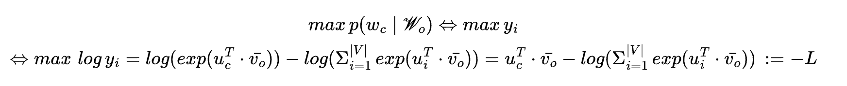

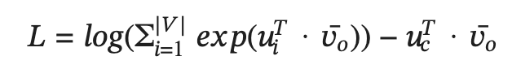
CBOW model Training
with y_{i} is the i-th element of the y vector - i is index of word c in dictionary
Thus:
y_{i}
Loss of sequence T:
V-dim
Notes:
biến đổi chi tiết hơn L => L_

Slide 44
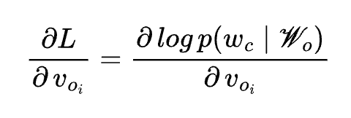
CBOW model Training
Through differentiation, we can obtain its gradient with respect to any context word vector 𝑣_{O𝑖} (𝑖=1,...,2𝑚) as:

Slide 45
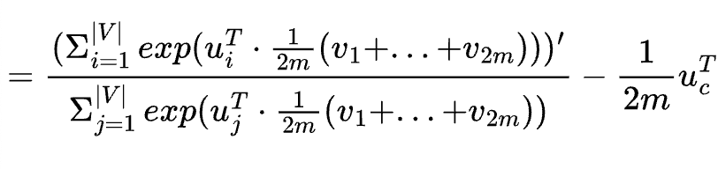
CBOW model Training
Through differentiation, we can obtain its gradient with respect to any context word vector 𝑣_{O𝑖} (𝑖=1,...,2𝑚) as:
Notes:
dư T chỗ u_c

Slide 46
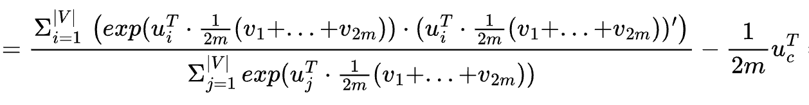
CBOW model Training
Through differentiation, we can obtain its gradient with respect to any context word vector 𝑣_{O𝑖} (𝑖=1,...,2𝑚) as:

Slide 47
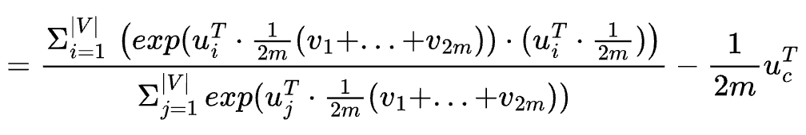
CBOW model Training
Through differentiation, we can obtain its gradient with respect to any context word vector 𝑣_{O𝑖} (𝑖=1,...,2𝑚) as:

Slide 48
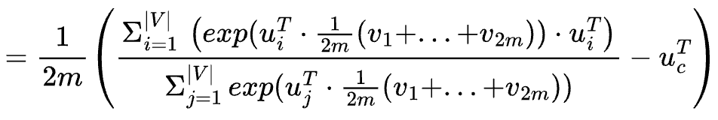
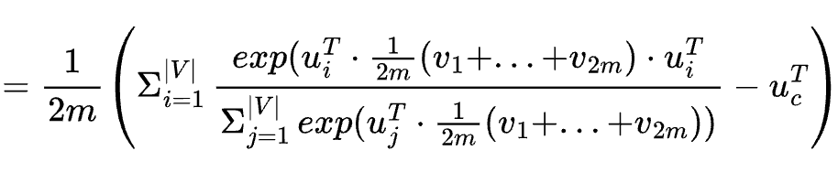
CBOW model Training
Through differentiation, we can obtain its gradient with respect to any context word vector 𝑣_{O𝑖} (𝑖=1,...,2𝑚) as:

Slide 49
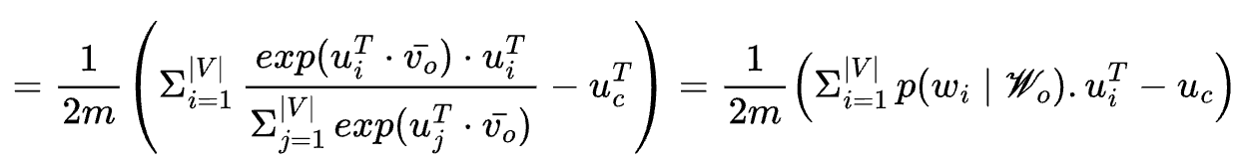
CBOW model Training
Through differentiation, we can obtain its gradient with respect to any context word vector 𝑣_{O𝑖} (𝑖=1,...,2𝑚) as:
Since 2𝑚 ≪ |𝑉| in language tasks: 𝑂(|𝑉|)

Slide 50
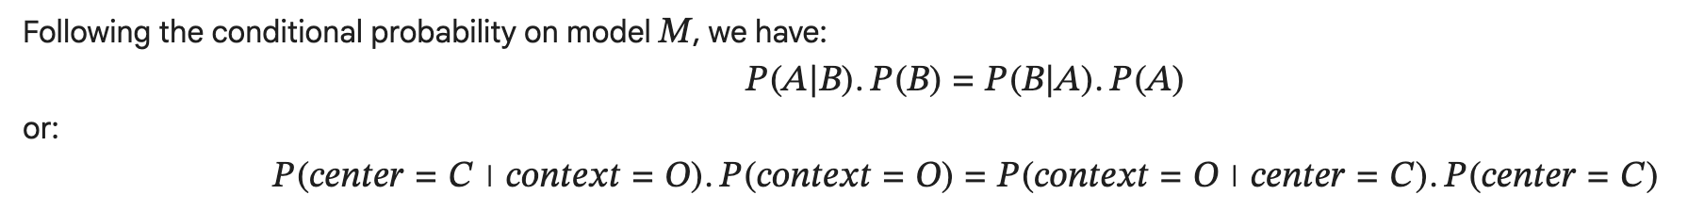
Skip-Gram Model
Reversely to model M:
Therefore, for any word with index 𝑖 in the dictionary, we call vector 𝑣_{𝑖} ∈ ℝ^{𝑁} as its representation in center role and vector 𝑢_{𝑖} ∈ ℝ^{𝑁} as its representation in context role.
Why CBOW and Skip-Gram are consistent:

Slide 51
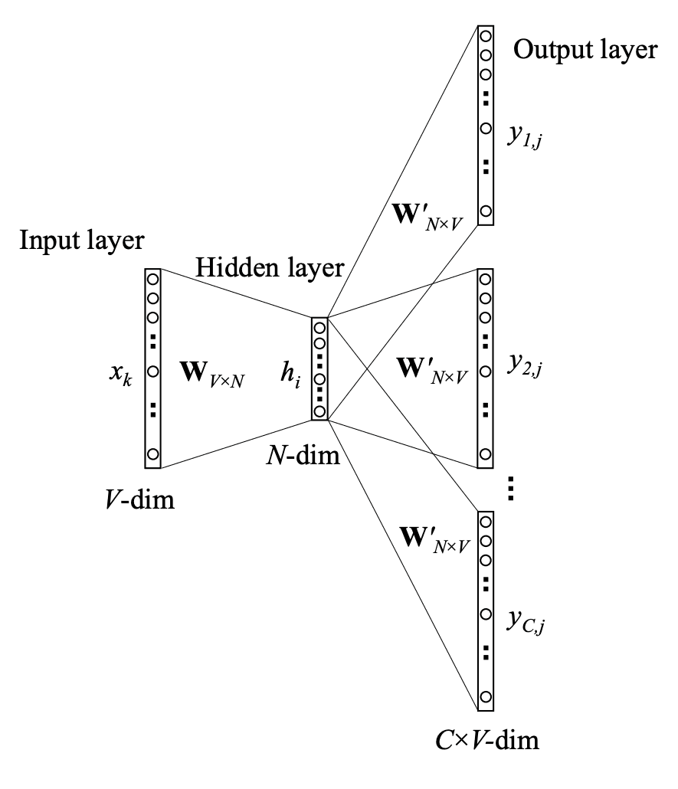
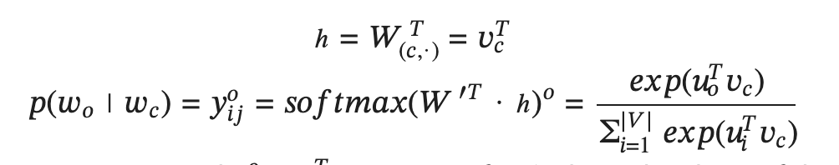
Architecture
𝑊_{𝑉 𝑥 𝑁} is the weights matrix whose each row at index 𝑖 is the 𝑣_{𝑖} vector of word 𝑖 in dictionary.
𝑊 ’_{𝑁 𝑥 𝑉} is the weights matrix whose each column at index 𝑗 is the 𝑢_{𝑗} vector of word 𝑗 in dictionary.
Similar to CBOW, at output layer with softmax, we have 𝑝(𝑤_{𝑜} ∣ 𝑤_{𝑐}) formula as below, where 𝑤_{𝑜} is the word at index 𝑜 and 𝑤_{𝑐} is the word at index 𝑐 in the dictionary.

Slide 52
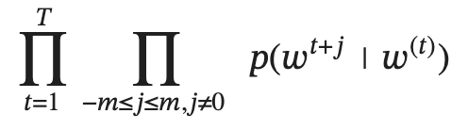
Training
Maximum likelihood estimation

Slide 53
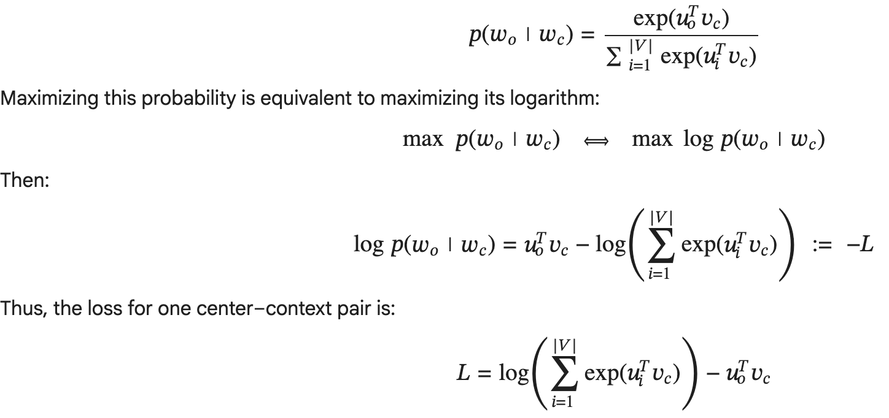
Training

Slide 54


Training

Slide 55
Approximate Training

Slide 56








Why approximate training?

Slide 57


Negative Sampling in Skip-Gram Model

Slide 58

Negative Sampling in Skip-Gram Model

Slide 59


Negative Sampling in Continuous Bag-of-words Model

Slide 60

Negative Sampling in Continuous Bag-of-words Model

Slide 61
Negative Sampling in Continuous Bag-of-words Model

Slide 62

How can we sample noise words in negative sampling?

Slide 63

Hierarchical Softmax in Skip Gram Model

Slide 64

Hierarchical Softmax in Skip Gram Model

Slide 65

Hierarchical Softmax in Continuous Bag-of-words Model

Slide 66




Exercise

Slide 67
Thanks for watching and listening!

